Slide 1
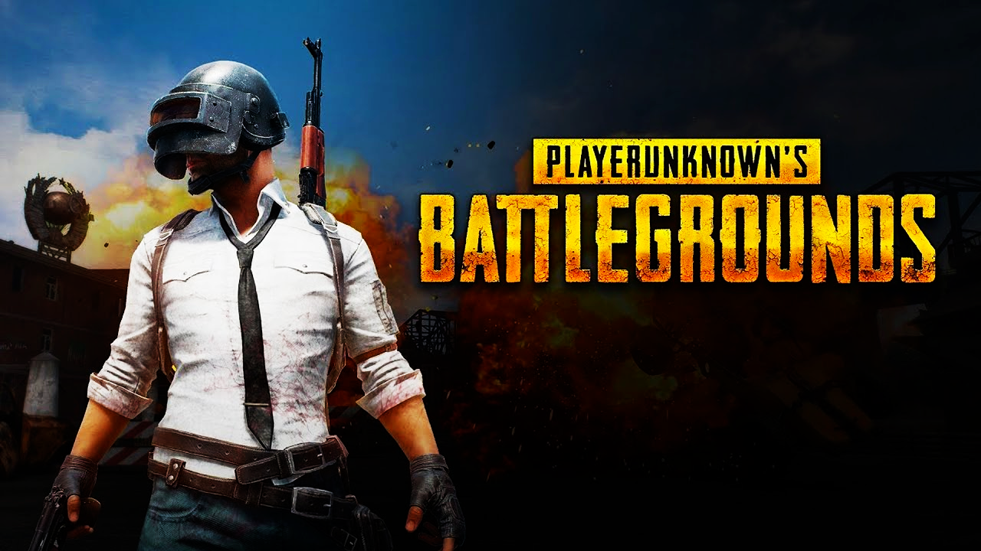
How to Survive in PUBG?

Slide 2
INTRO
~100 people parachute to an island in a match
Last one standing wins
Others get ranked based on how many other teams are still alive
Drive vehicles, walk, swim, grab weapons, shoot
Solo/Duo/Squad

Slide 3
The PROBLEM
What factors associated with the odds of being top 10% in a game?
What is a better strategy to increase the chance of getting into top 10%?

Slide 4
DATA Processing
Features selected/created
Aggregated by each group by each match, take average player performance
Outcome: whether is top 10 placement percentile (Same team has same ranking)
Random sampled 10,000 records
10,000 groups
5,214 matches
Binary (Most cluster around 0)
Assists_bi
Revives_bi
teamKills_bi
vehicleDestroys_bi
roadKills_bi
Continuous (mean centered)
Kills&knockedc
totalDistancec
Headshot_ratec
numGroups
Heals
Boosts

Slide 5
EDA
For categorical variables Chi-square test:
assists_bi
revives_bi
teamKills_bi
vehicleDestroys_bi
roadKills_bi

Slide 6
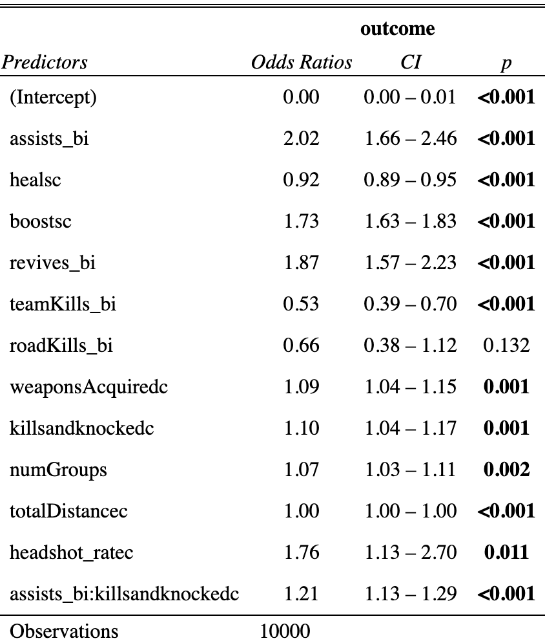
LOGISTIC Model

Slide 7
Assessment
Accuracy = 90% (0.3 cutoff) Sensitivity = 56% Specificity =94% AUC = 0.90
10-fold Cross Validation mean(AUC) = 0.90
Residual Plots
Higher order relationship?
Outliers

Slide 8
Limitations
Low sensitivity – bad at predicting 1s
Dependency in the model
Transformations attempted but failed
Other variables
Weapon type / Medic type
Maps chosen
Location of landing
Reasons of death

Slide 9

Conclusion
Always help your teammates Do not kill them
Be aggressive
Shoot accurately
Keep higher booster meter
Travel distance does not matter much
Notes:
Be Aggressive
It is very natural for peaceful persons like me to wanna avoid conflicts,
Shoot accurately
In PUBG, whenever you shoot will expose where you are.
Injured enemies can still be dangerous especially in team settings.
Better make sure they are dead dead
Boost
The only way to get above 75% HP + speed up
Good idea to keep full booster meter, especially when it gets down to less contestants

Slide 10
THANK YOU!

